Slide 1
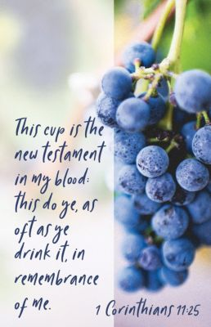
Level Green Presbyterian Church
July 7, 2024

Slide 2
video

Slide 3
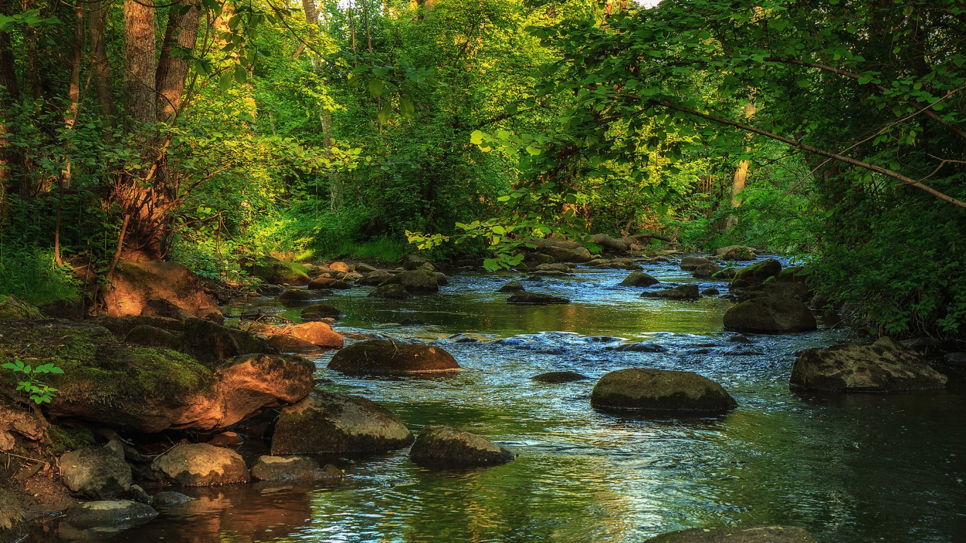
PRELUDE
A time to prepare
our hearts and minds
to worship the Lord.

Slide 4
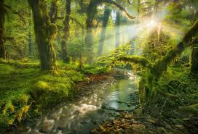
CALL TO
WORSHIP

Slide 5
Leader:
Within Your temple, O God,
People:
We meditate on Your unfailing love.

Slide 6
Leader:
Like Your name, O God, Your praise reaches to the ends of the earth;
People:
Your right hand is filled with righteousness.

Slide 7
Leader:
For this God is our God for ever and ever;
All:
He will be our guide even to the end.

Slide 9
Hymn #342
CCLI# 245077

Slide 10
Come, Christians, join to sing
Alleluia! Amen!
Loud praise to Christ our King;
Alleluia! Amen!

Slide 11
Let all, with heart and voice,
Before His throne rejoice;
Praise is His gracious choice:
Alleluia! Amen!

Slide 12
Come, lift your hearts on high;
Alleluia! Amen!
Let praises fill the sky;
Alleluia! Amen!

Slide 13
He is our Guide and Friend;
To us He’ll condescend;
His love shall never end:
Alleluia! Amen!

Slide 14
Praise yet our Christ again;
Alleluia! Amen!
Life shall not end the strain;
Alleluia! Amen!

Slide 15
On heaven’s blissful shore,
His goodness we’ll adore,
Singing forever more,
Alleluia! Amen!

Slide 16
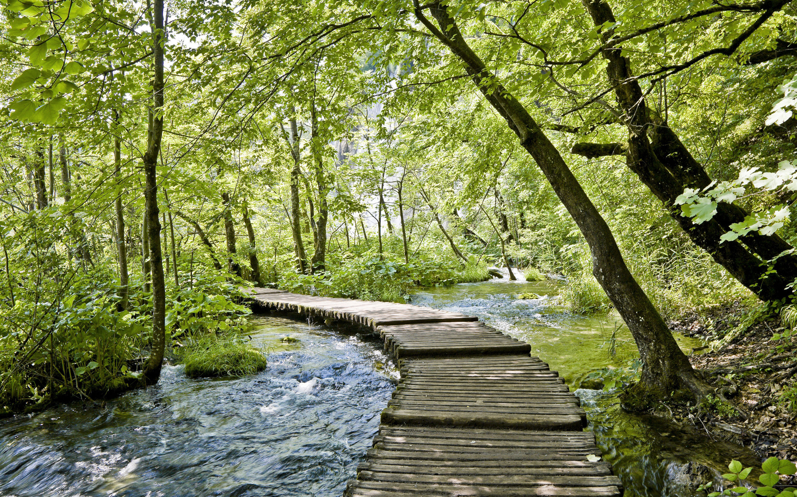
Apostles’
Creed

Slide 17
I BELIEVE in God the Father Almighty, Maker of heaven and earth,
And in Jesus Christ
his only Son our Lord;
who was conceived by the Holy Ghost, born of the Virgin Mary,
suffered under Pontius Pilate,
was crucified, dead, and buried;
he descended into hell;

Slide 18
the third day
he rose again from the dead;
he ascended into heaven,
and sitteth on the right hand of God
the Father Almighty;
from thence he shall come to judge
the quick and the dead.

Slide 19
I believe in the Holy Ghost;
the holy catholic Church;
the communion of saints;
the forgiveness of sins;
the resurrection of the body;
and the life everlasting.
Amen.

Slide 20
Prayer of Confession

Slide 21
God of grace and God of glory, we want glory for ourselves. We want to be strong and independent. We daydream about doing great things. We forget that we depend on You for everything: for the very air we breathe; for Your strength that holds us together; for life in the community You create in Christ; for the forgiveness that makes new life possible. In Your mercy, bind us together and send us out to proclaim the Good News of Your Kingdom. We pray in the name of the Lord Jesus Christ. Amen.

Slide 23
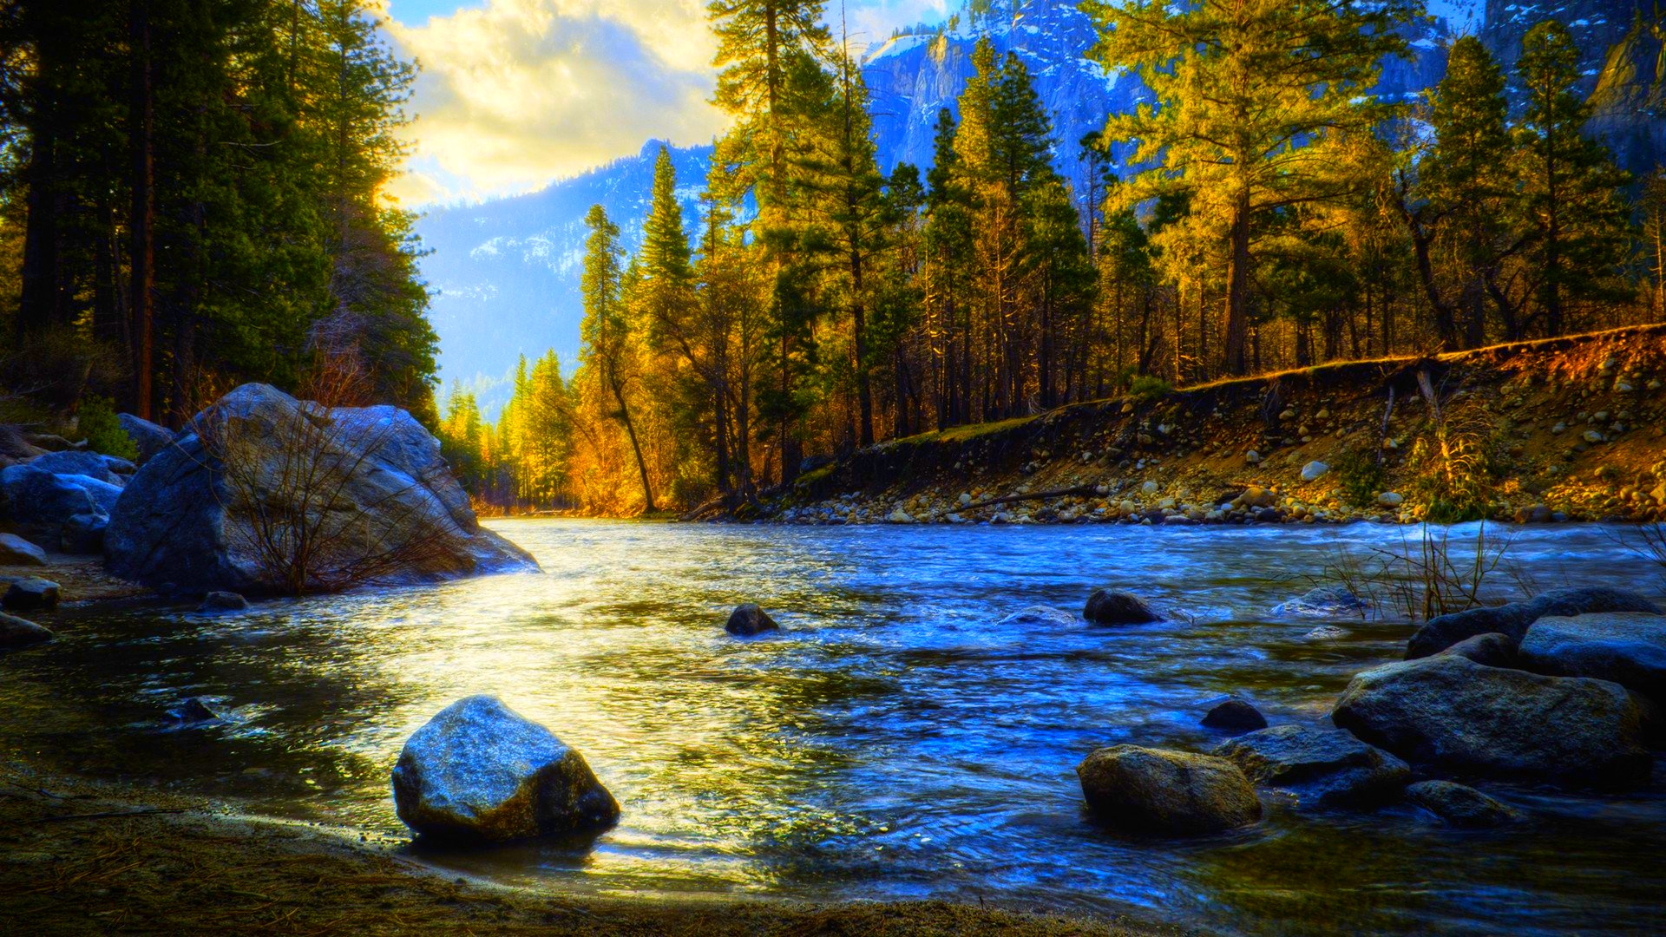
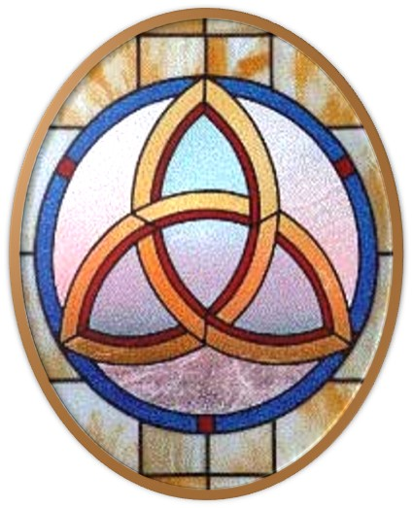
Gloria Patri
Hymn #142
CCLI #245077

Slide 24
Glory be to the Father
and to the Son
and to the Holy Ghost,
as it was in the beginning
is now and ever shall be,
world without end.
Amen, Amen.

Slide 27
Beautiful Isle of Somewhere

Slide 30
Hymn #382
CCLI #245077

Slide 31
Praise God,
From whom all blessings flow;
Praise Him,
All creatures here below;
Praise Him above,
Ye heavenly host;
Praise Father, Son,
And Holy Ghost. Amen

Slide 33
Isaiah 61:1-3 (NIV)

Slide 34
The Spirit of the Sovereign Lord is on me, because the Lord has anointed me to proclaim good news to the poor. He has sent me to bind up the brokenhearted, to proclaim freedom for the captives and release from darkness for the prisoners, ²to proclaim the year of the Lord’s favor and the day of vengeance of our God, to comfort all who mourn, ³and provide for those who grieve in Zion— to bestow on them a crown of beauty instead of ashes, the oil of joy instead of mourning, and a garment of praise instead of a spirit of despair.

Slide 35
They will be called oaks of righteousness, a planting of the Lord for the display of his splendor.

Slide 36
1 Corinthians 3:1-9 (NIV)

Slide 37
Brothers and sisters, I could not address you as people who live by the Spirit but as people who are still worldly—mere infants in Christ. ²I gave you milk, not solid food, for you were not yet ready for it. Indeed, you are still not ready. ³You are still worldly. For since there is jealousy and quarreling among you, are you not worldly? Are you not acting like mere humans? ⁴For when one says, “I follow Paul,” and another, “I follow Apollos,” are you not mere human beings? ⁵What, after all, is Apollos? And what is Paul? Only servants,

Slide 38
through whom you came to believe—as the Lord has assigned to each his task. ⁶I planted the seed, Apollos watered it, but God has been making it grow. ⁷So neither the one who plants nor the one who waters is anything, but only God, who makes things grow. ⁸The one who plants and the one who waters have one purpose, and they will each be rewarded according to their own labor. ⁹For we are co-workers in God’s service; you are God’s field, God’s building.

Slide 40
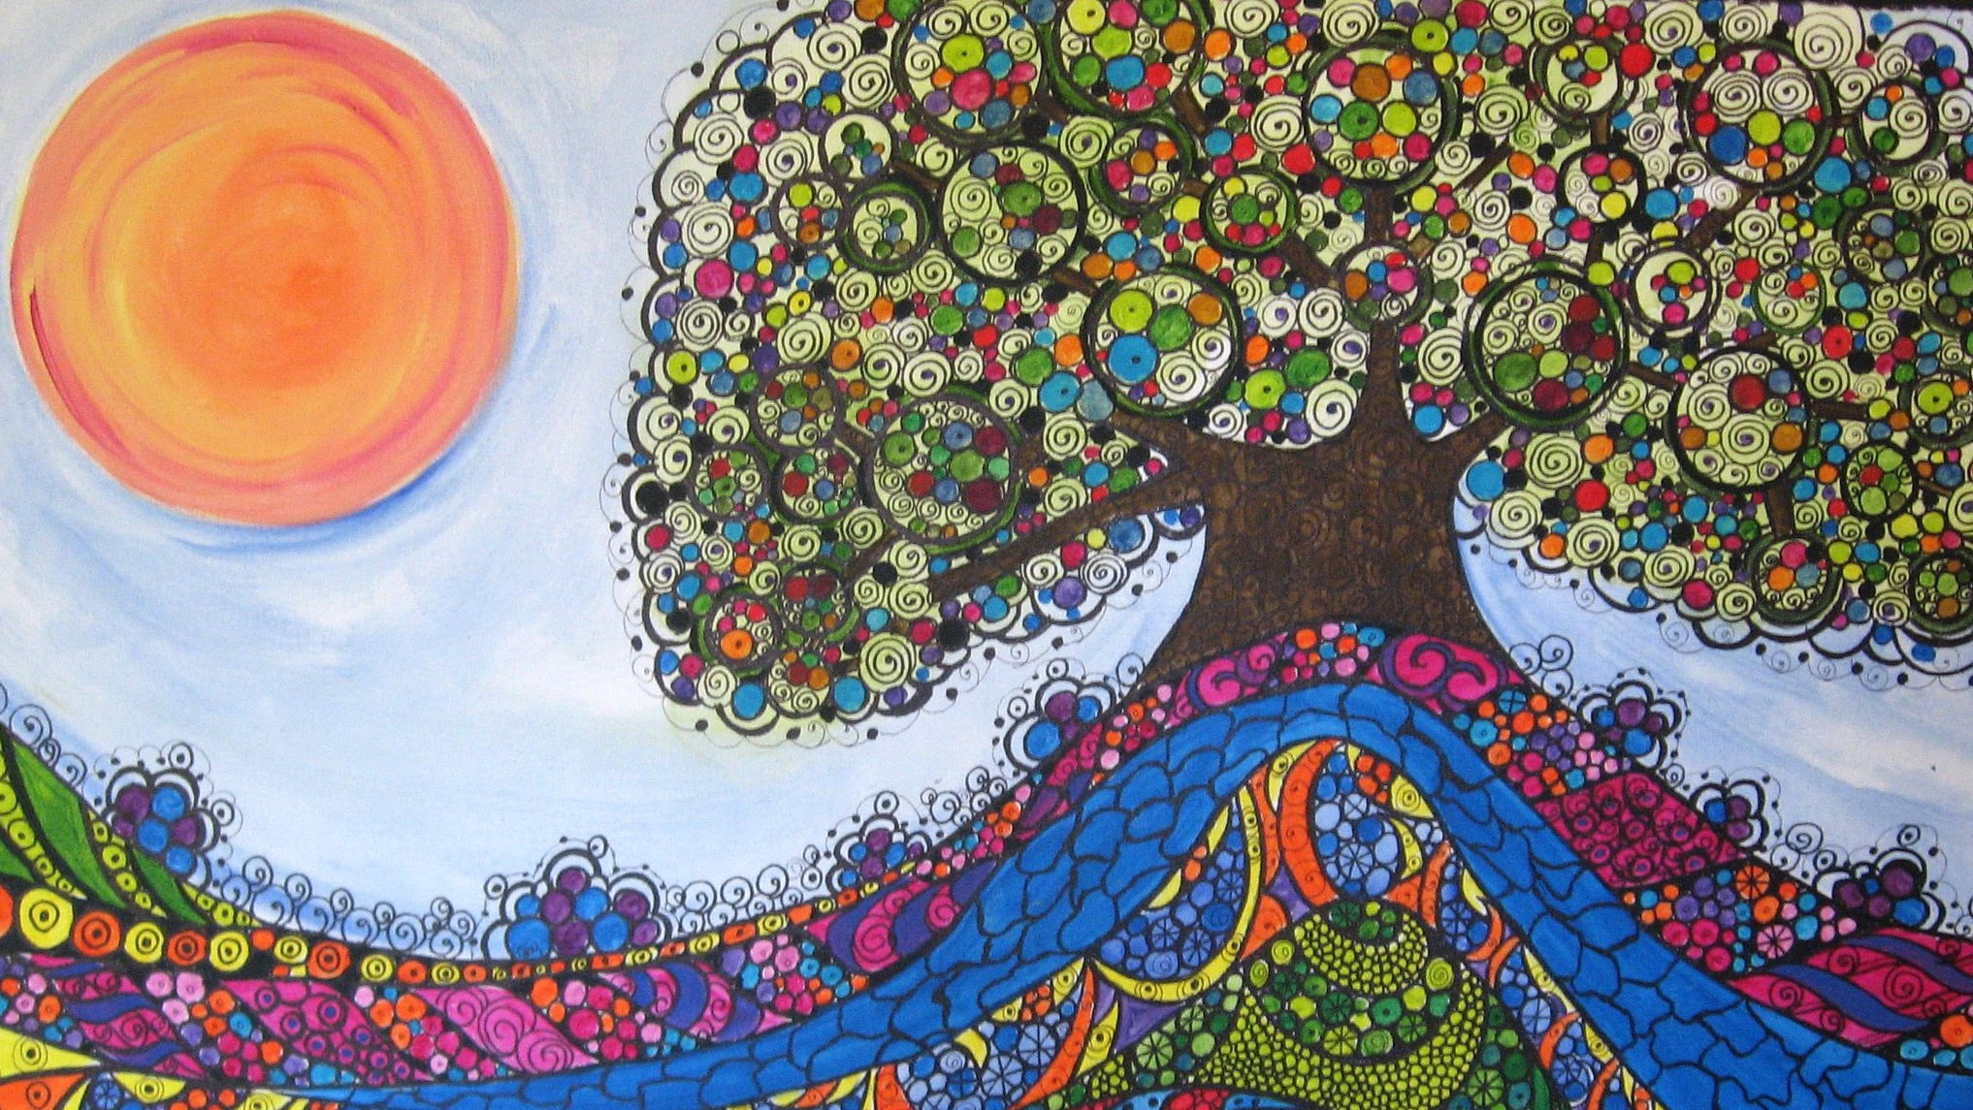
God Makes Things Grow

Slide 41
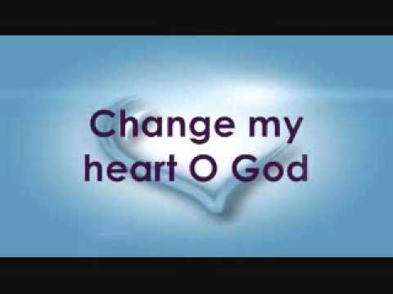
Praise Book
CCLI# 245077

Slide 42
Change my heart, O God,
Make it ever true;
Change my heart, O God,
May I be like You.
Change my heart, O God,
Make it ever true;
Change my heart, O God,
May I be like You.

Slide 43
You are the Potter,
I am the clay;
Mold me and make me,
This is what I pray.
Change my heart, O God,
Make it ever true;
Change my heart, O God,
May I be like You.

Slide 44
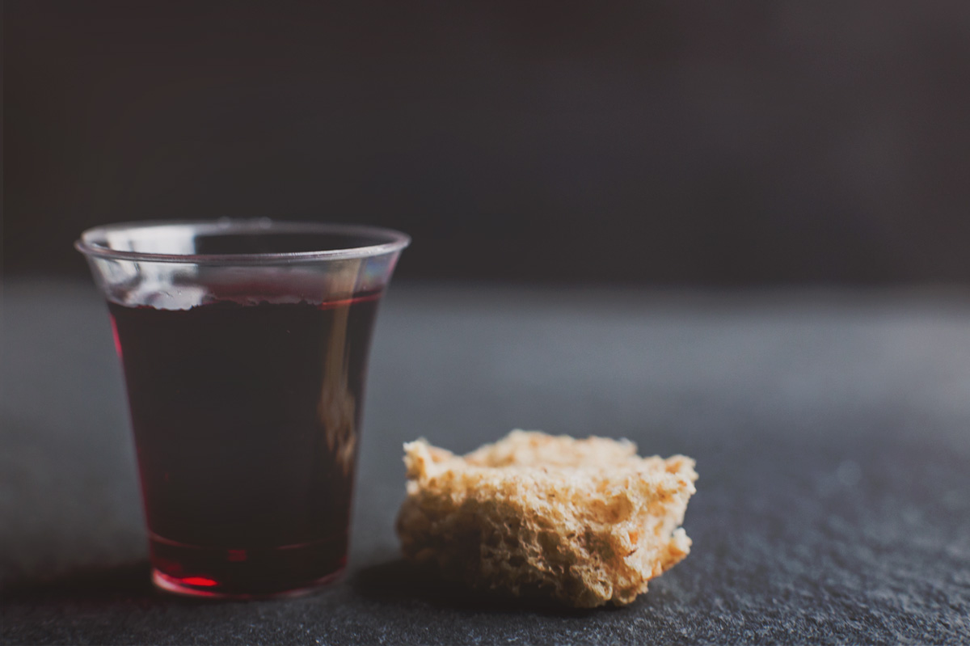
THE SACRAMENT OF THE LORD’S SUPPER
Just As I AM, Without One Plea
CCLI# 245077

Slide 45
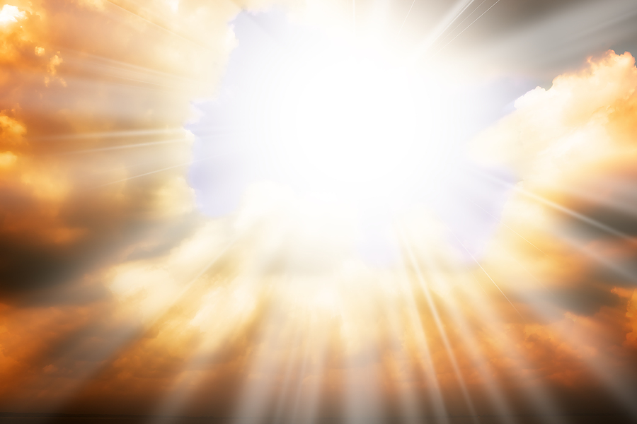
God of Grace and God of Glory
Hymn #528
CCLI# 245077

Slide 46
God of grace and God of glory,
On Thy people pour Thy power;
Crown Thine ancient Church’s story,
Bring her bud to glorious flower.

Slide 47
Grant us wisdom,
Grant us courage,
For the facing of this hour,
For the facing of this hour.

Slide 48
Lo! The hosts of evil round us
Scorn Thy Christ, assail His ways!
From the fears that long have bound us,
Free our hearts to faith and praise.

Slide 49
Grant us wisdom,
Grant us courage,
For the living of these days,
For the living of these days.

Slide 50
Cure Thy children’s warring madness;
Bend our pride to Thy control;
Shame our wanton, selfish gladness,
Rich in things and poor in soul.

Slide 51
Grant us wisdom,
Grant us courage,
Lest we miss Thy kingdom’s goal,
Lest we miss Thy kingdom’s goal.

Slide 52
Set our feet on lofty places,
Gird our lives that they may be
Armored with all Christ-like graces
In the fight to set men free.

Slide 53
Grant us wisdom,
Grant us courage,
That we fail not man nor Thee,
That we fail not man nor Thee.

Slide 54
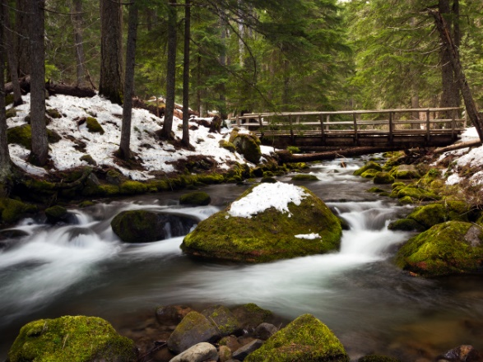
BENEDICTION

Slide 55
POSTLUDE
Have a
good week!

