Slide 1
Level Green Presbyterian Church
November 24, 2024

Slide 2
Video
Play it forward

Slide 3
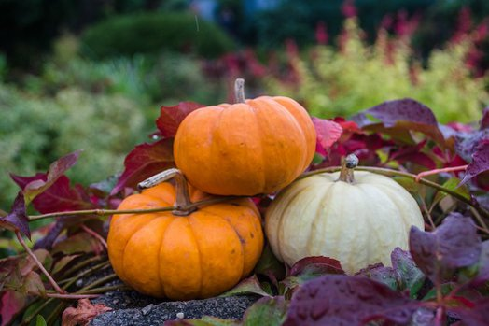
PRELUDE
A time to prepare
our hearts and minds
to worship the Lord.

Slide 4
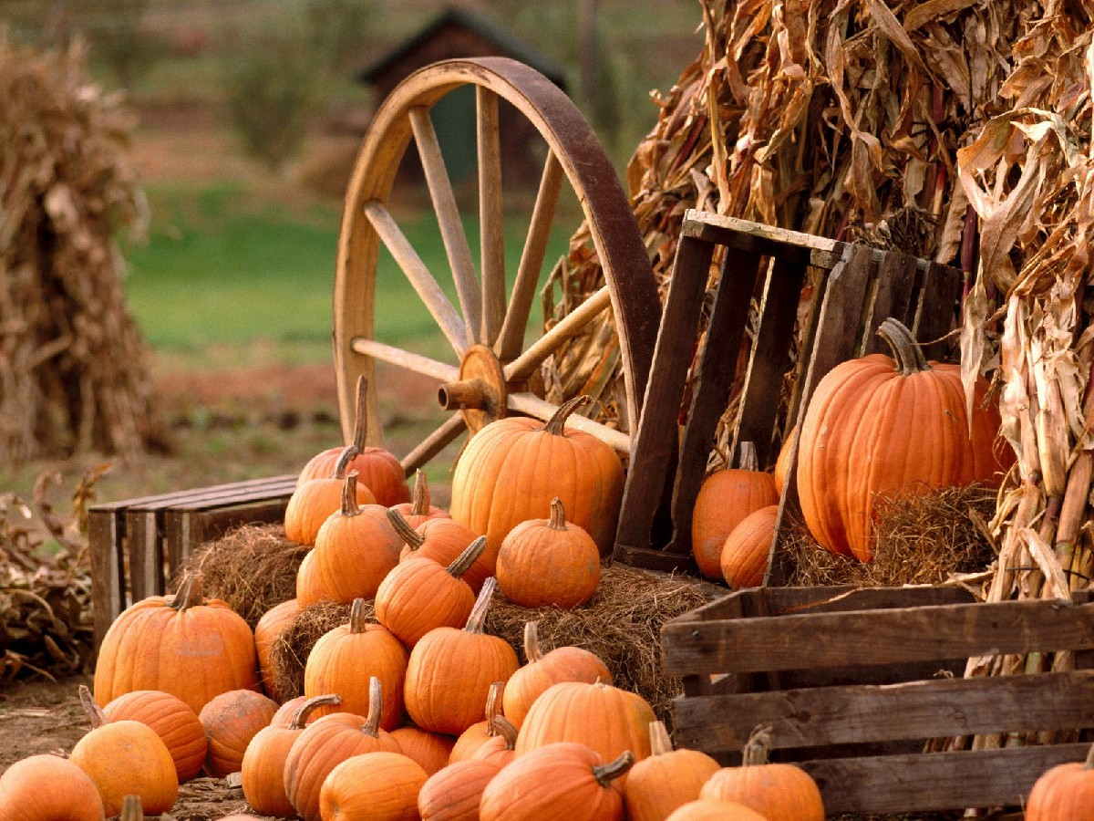
CALL TO
WORSHIP

Slide 5
Leader:
The Lord reigns, He is robed in majesty;
People:
The Lord is robed in majesty and armed with strength;

Slide 6
Leader:
Indeed, the world is established, firm and secure.
People:
Your throne was established long ago;

Slide 7
Leader:
You are from all eternity.
All:
Your statutes, Lord, stand firm for endless days.

Slide 9
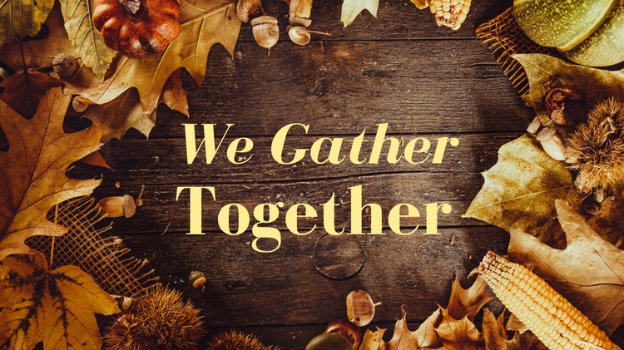
Hymn #387
CCLI# 245077

Slide 10
We gather together
To ask the Lord’s blessing
He chastens and hastens
His will to make known;
The wicked oppressing
Now cease from distressing:
Sing praises to His name
He forgets not His own.

Slide 11
Beside us to guide us,
Our God with us joining,
Ordaining, maintaining
His kingdom divine;
So from the beginning
The fight we were winning:
Thou, Lord, wast at our side
All glory be Thine.

Slide 12
We all do extol Thee,
Thou leader triumphant,
And pray that Thou still
Our defender wilt be;
Let Thy congregation
Escape tribulation:
Thy name be ever praised!
O Lord, make us free!

Slide 13
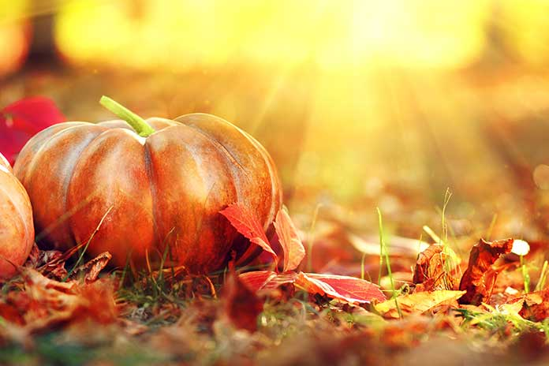
The Apostles’ Creed

Slide 14
I BELIEVE in God the Father Almighty, Maker of heaven and earth,
And in Jesus Christ
his only Son our Lord;
who was conceived by the Holy Ghost, born of the Virgin Mary,
suffered under Pontius Pilate,
was crucified, dead, and buried;
he descended into hell;

Slide 15
the third day
he rose again from the dead;
he ascended into heaven,
and sitteth on the right hand of God
the Father Almighty;
from thence he shall come to judge
the quick and the dead.

Slide 16
I believe in the Holy Ghost;
the holy catholic Church;
the communion of saints;
the forgiveness of sins;
the resurrection of the body;
and the life everlasting.
Amen.

Slide 17
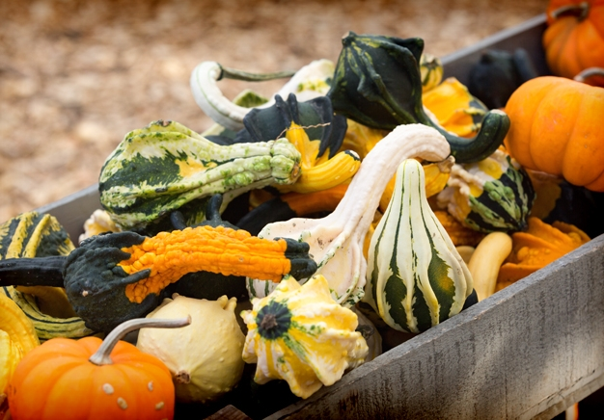
Prayer of Confession

Slide 18
Risen Christ, You are Lord of Lords! You are King of Kings, and no one works like You! We proclaim Your Kingdom with our lips and voices, but not so much with our living. Too often the things we want are rulers of our lives. Too often our own needs get all our attention and not the needs of others. This is not what life in Your Kingdom should look like. Christ our King, you did not come to condemn, but to love. Love us in the power of Your forgiveness, and make our lives a witness to Your tender sovereignty. We pray in the name of our eternal King Jesus Christ. Amen.

Slide 20
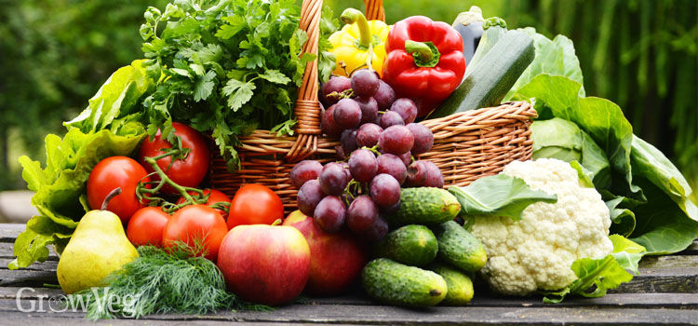
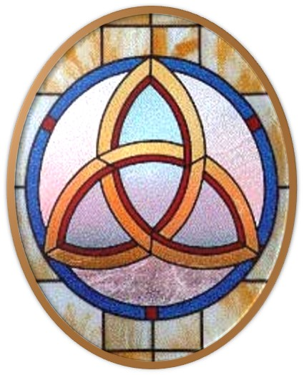
Gloria Patri
Hymn #142
CCLI #245077

Slide 21
Glory be to the Father
and to the Son
and to the Holy Ghost,
as it was in the beginning
is now and ever shall be,
world without end.
Amen, Amen.

Slide 24
Give Thanks To The Lord

Slide 26
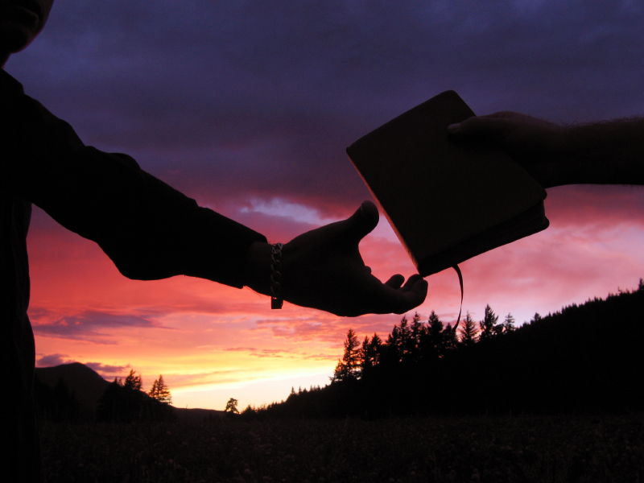

Slide 28
Hymn #382
CCLI #245077

Slide 29
Praise God,
From whom all blessings flow;
Praise Him,
All creatures here below;
Praise Him above,
Ye heavenly host;
Praise Father, Son,
And Holy Ghost. Amen

Slide 31
Praise Book
CCLI# 245077

Slide 32
Give thanks with a grateful heart,
Give thanks to the Holy One;
Give Thanks because
He’s given Jesus Christ, His Son.

Slide 33
Give thanks with a grateful heart,
Give thanks to the Holy One;
Give Thanks because
He’s given Jesus Christ, His Son.

Slide 34
And now let the weak say,
“I am strong,”
Let the poor say, “I am rich”
Because of what the Lord
has done for us;

Slide 35
And now let the weak say,
“I am strong,”
Let the poor say, “I am rich”
Because of what the Lord
has done for us.
Give Thanks.

Slide 37
Zechariah 13:7-9 (NIV)

Slide 38
⁷“Awake, sword, against my shepherd, against the man who is close to me!” declares the Lord Almighty. “Strike the shepherd, and the sheep will be scattered, and I will turn my hand against the little ones. ⁸In the whole land,” declares the Lord, “two-thirds will be struck down and perish; yet one-third will be left in it. ⁹This third I will put into the fire; I will refine them like silver and test them like gold. They will call on my name and I will answer them; I will say, ‘They are my people,’ and they will say, ‘The Lord is our God.’”

Slide 39
1 Corinthians 15:1-11 (NIV)

Slide 40
Now, brothers and sisters, I want to remind you of the gospel I preached to you, which you received and on which you have taken your stand. ²By this gospel you are saved, if you hold firmly to the word I preached to you. Otherwise, you have believed in vain. ³For what I received I passed on to you as of first importance: that Christ died for our sins according to the Scriptures, ⁴that he was buried, that he was raised on the third day according to the Scriptures, ⁵and that he appeared to Cephas, and then to the Twelve.

Slide 41
⁶After that, he appeared to more than five hundred of the brothers and sisters at the same time, most of whom are still living, though some have fallen asleep. ⁷Then he appeared to James, then to all the apostles, ⁸and last of all he appeared to me also, as to one abnormally born. ⁹For I am the least of the apostles and do not even deserve to be called an apostle, because I persecuted the church of God. ¹⁰But by the grace of God I am what I am, and his grace to me was not without effect.

Slide 42
No, I worked harder than all of them—yet not I, but the grace of God that was with me. ¹¹Whether, then, it is I or they, this is what we preach, and this is what you believed.

Slide 44
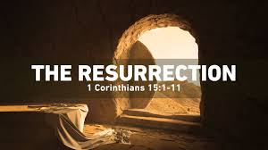
An Easter Message
on Thanksgiving

Slide 45
Hymn #392
CCLI# 245077

Slide 46
Come, ye thankful people, come,
Raise the song of harvest home;
All is safely gathered in,
Ere the winter storms begin:
God, our Maker, doth provide
For our wants to be supplied;
Come to God’s own temple, come,
Raise the song of harvest home.

Slide 47
All the world is Gods’ own field,
Fruit unto His praise to yield;
Wheat and tares together sown,
Unto joy or sorrows grown:
First the blade, and then the ear,
Then the full corn shall appear;
Lord of harvest, grant that we
Wholesome grain and pure may be.

Slide 48
For the Lord our God shall come
And shall take His harvest home;
From His field shall in that day
All offenses purge away,
Give His angels charge at last
In the fire the tares to cast,
But the fruitful ears to store
In His garner evermore.

Slide 49
Even so, Lord, quickly come
To Thy final harvest home;
Gather Thou thy people in,
Free from sorrow, free from sin:
There forever purified,
In Thy presence to abide;
Come, with all thine angels, come,
Raise the glorious harvest home.

Slide 50
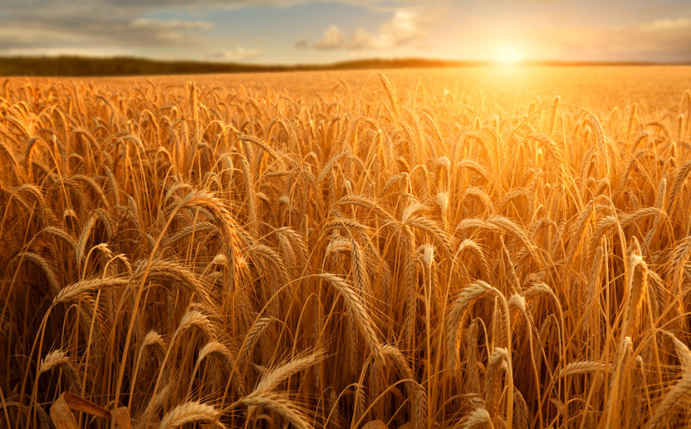
BENEDICTION

Slide 51
POSTLUDE
Have a
good week!

