Slide 1
Level Green Presbyterian Church
December 1, 2024

Slide 2
PRELUDE
A time to prepare
our hearts and minds
to worship the Lord.

Slide 5
Hymn #169
CCLI# 245077

Slide 6
O come, O come, Emmanuel,
And ransom captive Israel,
That mourns in lonely exile here,
Until the Son of God appear.

Slide 7
Rejoice! Rejoice!
Emmanuel
Shall come to thee,
O Israel!

Slide 8
O come, Thou Day-spring,
Come and cheer
Our spirits by Thine advent here;
Disperse the gloomy clouds of night,
And death’s dark shadows
put to flight.

Slide 9
Rejoice! Rejoice!
Emmanuel
Shall come to thee,
O Israel!

Slide 10
O come, Thou Wisdom from on high,
And order all things, far and nigh;
To us the path of knowledge show,
And cause us in her ways to go.

Slide 11
Rejoice! Rejoice!
Emmanuel
Shall come to thee,
O Israel!

Slide 12
O come, Desire of nations, bind
In one the hearts of all man-kind;
Bid Thou our sad divisions cease,
And be Thyself our King of peace.

Slide 13
Rejoice! Rejoice!
Emmanuel
Shall come to thee,
O Israel!

Slide 14
The Apostles’ Creed

Slide 15
I BELIEVE in God the Father Almighty, Maker of heaven and earth,
And in Jesus Christ
his only Son our Lord;
who was conceived by the Holy Ghost, born of the Virgin Mary,
suffered under Pontius Pilate,
was crucified, dead, and buried;
he descended into hell;

Slide 16
the third day
he rose again from the dead;
he ascended into heaven,
and sitteth on the right hand of God
the Father Almighty;
from thence he shall come to judge
the quick and the dead.

Slide 17
I believe in the Holy Ghost;
the holy catholic Church;
the communion of saints;
the forgiveness of sins;
the resurrection of the body;
and the life everlasting.
Amen.

Slide 18
Prayer of Confession

Slide 19
Coming Lord, as we wait and watch and yearn and ache, we look around for signs of Your presence. What we see mostly are indications of our sinfulness. The needy are overlooked. Selfishness has the upper hand. Hatred and violence triumph over peace and reconciliation. Our commitments waver; our resolve weakens; and we find ourselves further away from the path for which You have marked in Christ. We long for a word of forgiveness and direction, and for a sense of purpose and meaning. Come quickly, Lord. With mercy and grace, come quickly Lord. We pray in the name of our Savior Jesus Christ. Amen.

Slide 21
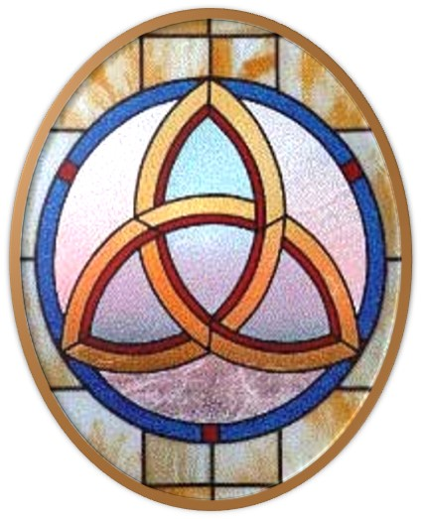
Gloria Patri
Hymn #142
CCLI #245077

Slide 22
Glory be to the Father
and to the Son
and to the Holy Ghost,
as it was in the beginning
is now and ever shall be,
world without end.
Amen, Amen.

Slide 25
Star of Bethlehem

Slide 26
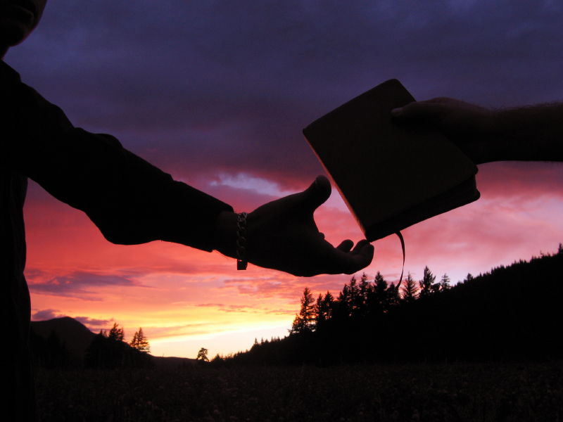

Slide 28
Hymn #382
CCLI #245077

Slide 29
Praise God,
From whom all blessings flow;
Praise Him,
All creatures here below;
Praise Him above,
Ye heavenly host;
Praise Father, Son,
And Holy Ghost. Amen

Slide 31
Psalm 25:1-10 (NIV)

Slide 32
In you, Lord my God, I put my trust. ²I trust in you; do not let me be put to shame, nor let my enemies triumph over me. ³No one who hopes in you will ever be put to shame, but shame will come on those who are treacherous without cause. ⁴Show me your ways, Lord, teach me your paths. ⁵Guide me in your truth and teach me, for you are God my Savior, and my hope is in you all day long. ⁶Remember, Lord, your great mercy and love, for they are from of old. ⁷Do not remember the sins of my youth and my rebellious ways;

Slide 33
according to your love remember me, for you, Lord, are good. ⁸Good and upright is the Lord; therefore he instructs sinners in his ways. ⁹He guides the humble in what is right and teaches them his way. ¹⁰All the ways of the Lord are loving and faithful toward those who keep the demands of his covenant.

Slide 34
Luke 21:25-36 (NIV)

Slide 35
²⁵“There will be signs in the sun, moon and stars. On the earth, nations will be in anguish and perplexity at the roaring and tossing of the sea. ²⁶People will faint from terror, apprehensive of what is coming on the world, for the heavenly bodies will be shaken. ²⁷At that time they will see the Son of Man coming in a cloud with power and great glory. ²⁸When these things begin to take place, stand up and lift up your heads, because your redemption is drawing near.” ²⁹He told them this parable: “Look at the fig tree and all the trees.

Slide 36
³⁰When they sprout leaves, you can see for yourselves and know that summer is near. ³¹Even so, when you see these things happening, you know that the kingdom of God is near. ³²“Truly I tell you, this generation will certainly not pass away until all these things have happened. ³³Heaven and earth will pass away, but my words will never pass away. ³⁴“Be careful, or your hearts will be weighed down with carousing, drunkenness and the anxieties of life, and that day will close on you suddenly like a trap.

Slide 37
³⁵For it will come on all those who live on the face of the whole earth. ³⁶Be always on the watch, and pray that you may be able to escape all that is about to happen, and that you may be able to stand before the Son of Man.”

Slide 39
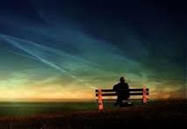
Always On The Watch

Slide 40
Praise Book
CCLI# 245077

Slide 41
Jesus,
Name above all names,
Beautiful Savior,
Glorious Lord.
Emmanuel,
God is with us,
Blessed Redeemer,
Living Word.

Slide 42
Jesus,
Loving Shepherd,
Vine of the branches,
Son of God.
Prince of Peace,
Wonderful Counselor,
Lord of the universe,
Light of the world.

Slide 43
Praise him,
Lord above all lords,
King above all kings,
God’s only Son,
The Prince of Peace,
Who by his Spirit
Come to live in us,
Master and Friend.

Slide 44
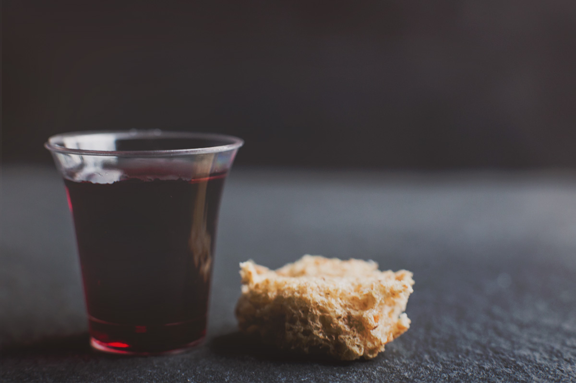
THE SACRAMENT OF THE LORD’S SUPPER
Just As I AM, Without One Plea
CCLI# 245077

Slide 45
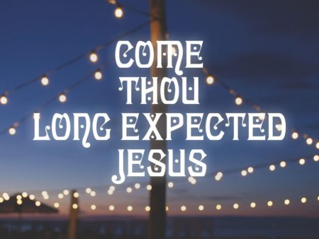
Hymn #168
CCLI# 245077

Slide 46
Come, Thou long expected Jesus,
Born to set Thy people free;
From fears and sins release us;
Let us find our rest in Thee.
Israel’s Strength and Consolation,
Hope of all the earth Thou art;
Dear Desire of every nation,
Joy of every longing heart.

Slide 47
Born Thy people to deliver,
Born a child and yet a King,
Born to reign in us forever,
Now Thy gracious Kingdom bring.
By Thine own eternal Spirit
Rule in all our hearts alone;
By Thine all sufficient merit
Raise us to Thy glorious throne.

Slide 48
BENEDICTION

Slide 49
POSTLUDE
Have a
good week!

