Slide 1
Level Green Presbyterian Church
October 13, 2024

Slide 2
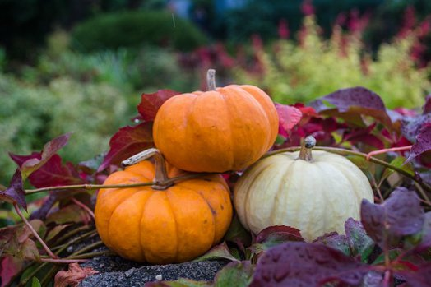
PRELUDE
A time to prepare
our hearts and minds
to worship the Lord.

Slide 3
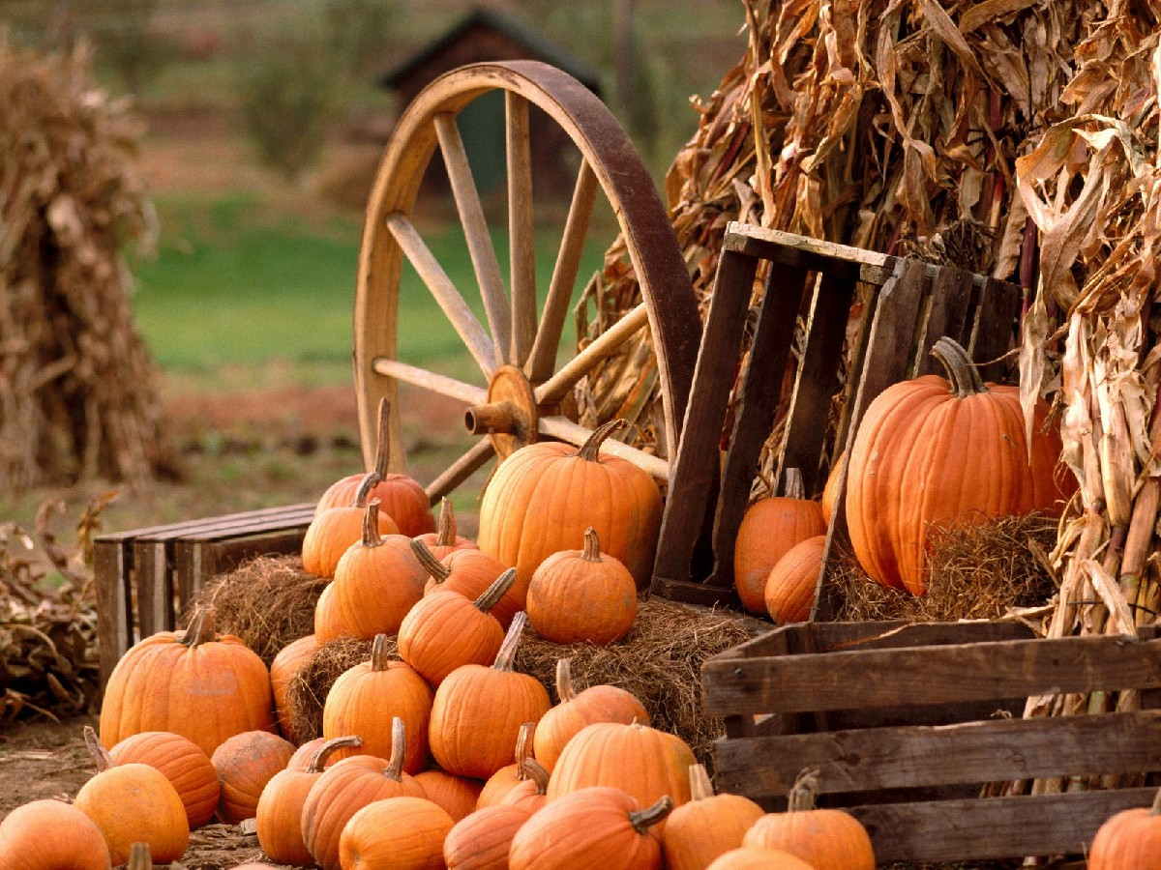
CALL TO
WORSHIP

Slide 4
Leader:
Teach us to number our days,
People:
That we may gain a heart of wisdom.

Slide 5
Leader:
Satisfy us in the morning with Your unfailing love,
People:
That we may sing for joy and be glad all our days.

Slide 6
Leader:
May the favor of the Lord our God rest on us;
All:
Establish the work of our hands for us.

Slide 8
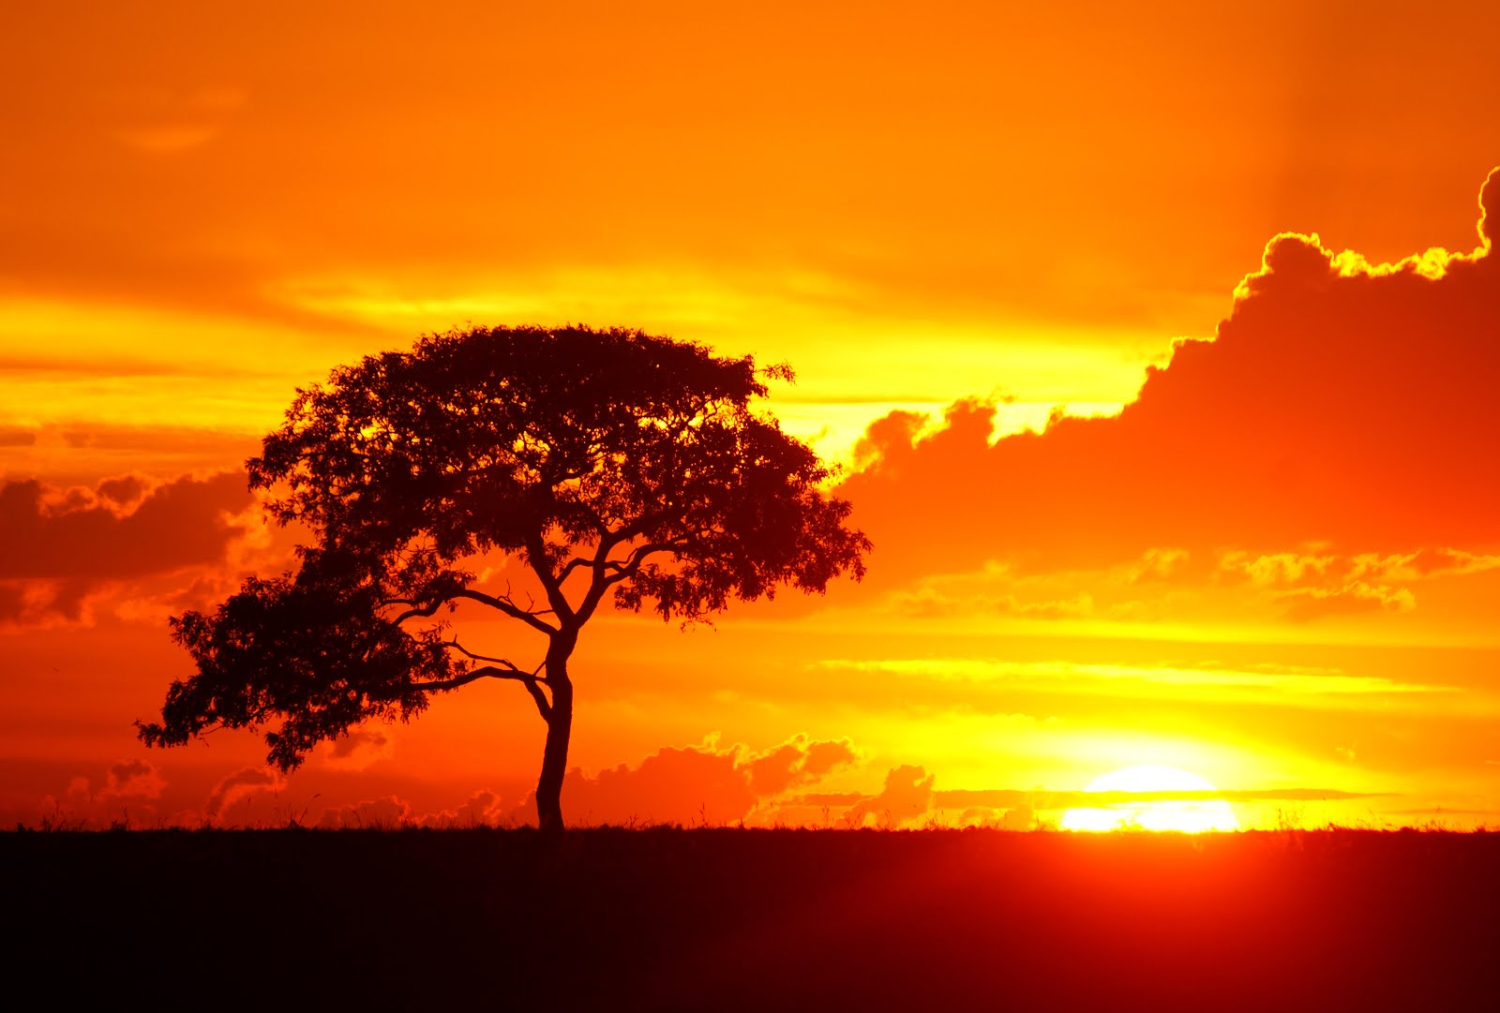
Jesus Shall Reign Where’er the Sun
Hymn # 238
CCLI# 245077

Slide 9
Jesus shall reign where’er the sun
Does His successive journeys run,
His kingdom spread from shore to shore,
‘Til moons shall wax and wane no more.

Slide 10
To Him shall endless prayer be made,
And endless praises crown His head;
His name like sweet perfume shall rise
With every morning sacrifice.

Slide 11
People and realms of every tongue
Dwell on His love with sweetest song;
And infant voices shall proclaim
Their early blessings on His name.

Slide 12
Let every creature rise and bring
His grateful honors to our King:
Angels descend with songs again,
And earth repeat the loud “Amen!”

Slide 13
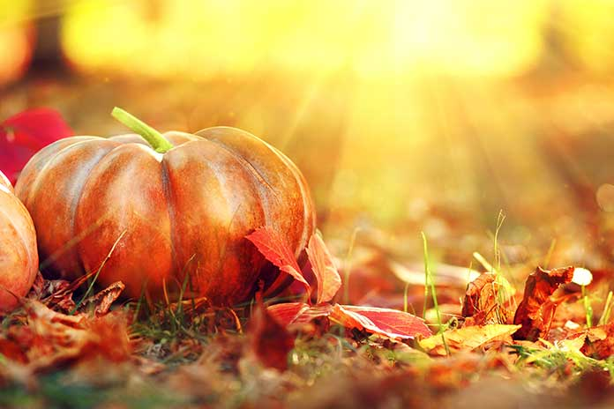
The Apostles’ Creed

Slide 14
I BELIEVE in God the Father Almighty, Maker of heaven and earth,
And in Jesus Christ
his only Son our Lord;
who was conceived by the Holy Ghost, born of the Virgin Mary,
suffered under Pontius Pilate,
was crucified, dead, and buried;
he descended into hell;

Slide 15
the third day
he rose again from the dead;
he ascended into heaven,
and sitteth on the right hand of God
the Father Almighty;
from thence he shall come to judge
the quick and the dead.

Slide 16
I believe in the Holy Ghost;
the holy catholic Church;
the communion of saints;
the forgiveness of sins;
the resurrection of the body;
and the life everlasting.
Amen.

Slide 17
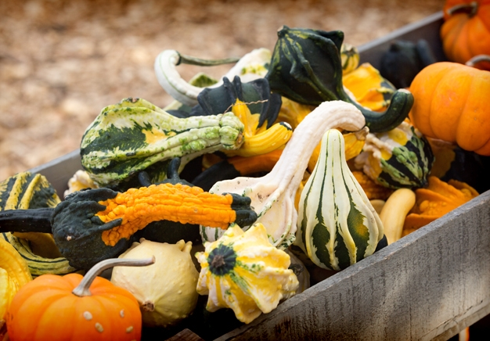
Prayer of Confession

Slide 18
O Lord, we are a proud people. We think more highly of ourselves than of others. We seek and seize the honor that others deserve. We vie for position and office. Lord, please forgive us and form us to be more like Jesus. May we think more highly of others than of ourselves. May we trust You rather than our own plans. May we use our positions to elevate others. We pray in the name of
Jesus Christ. Amen.

Slide 20
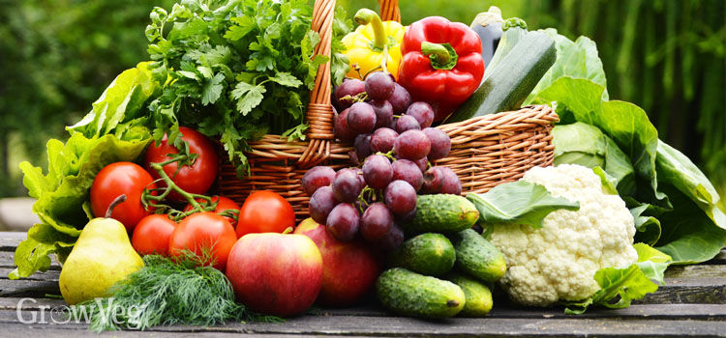
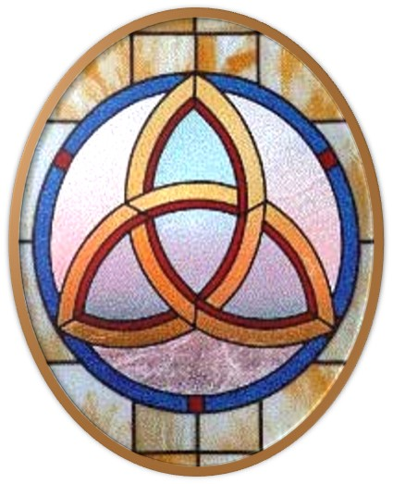
Gloria Patri
Hymn #142
CCLI #245077

Slide 21
Glory be to the Father
and to the Son
and to the Holy Ghost,
as it was in the beginning
is now and ever shall be,
world without end.
Amen, Amen.

Slide 24
Father Lead Me Day By Day

Slide 25
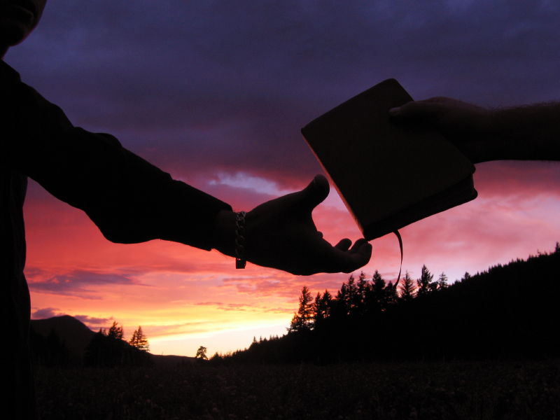

Slide 27
Hymn #382
CCLI #245077

Slide 28
Praise God,
From whom all blessings flow;
Praise Him,
All creatures here below;
Praise Him above,
Ye heavenly host;
Praise Father, Son,
And Holy Ghost. Amen

Slide 30
Praise Book
CCLI# 245077

Slide 31
Amazing grace, how sweet the sound, that saved a wretch like me.
I once was lost, but now I’m found, was blind but now I see.

Slide 32
‘Twas grace that taught my heart
to fear, and grace my fears relieved.
How precious did that grace appear, the hour I first believed.

Slide 33
My chains are gone.
I’ve been set free, my God, my Savior has ransomed me.
And like a flood His mercy rains, unending love, amazing grace.

Slide 34
The Lord has promised good to me,
His word my hope secures.
He will my shield and portion be, as long as life endures.

Slide 35
My chains are gone.
I’ve been set free, my God, my Savior has ransomed me.
And like a flood His mercy rains, unending love, amazing grace.

Slide 36
My chains are gone.
I’ve been set free, my God, my Savior has ransomed me.
And like a flood His mercy rains, unending love, amazing grace.

Slide 37
The earth shall soon dissolve like snow,
the sun forbear to shine.
But God, who called me here below, will be forever mine,
will be forever mine.
You are forever mine.

Slide 39
Genesis 2:18-25 (NIV)

Slide 40
¹⁸The Lord God said, “It is not good for the man to be alone. I will make a helper suitable for him.” ¹⁹Now the Lord God had formed out of the ground all the wild animals and all the birds in the sky. He brought them to the man to see what he would name them; and whatever the man called each living creature, that was its name. ²⁰So the man gave names to all the livestock, the birds in the sky and all the wild animals. But for Adam no suitable helper was found. ²¹So the Lord God caused the man to fall into a deep sleep; and while he was

Slide 41
sleeping, he took one of the man’s ribs and then closed up the place with flesh. ²²Then the Lord God made a woman from the rib he had taken out of the man, and he brought her to the man. ²³The man said, “This is now bone of my bones and flesh of my flesh; she shall be called ‘woman,’ for she was taken out of man.” ²⁴That is why a man leaves his father and mother and is united to his wife, and they become one flesh. ²⁵Adam and his wife were both naked, and they felt no shame.

Slide 42
1 Corinthians 6:1-20 (NIV)

Slide 43
If any of you has a dispute with another, do you dare to take it before the ungodly for judgment instead of before the Lord’s people? ²Or do you not know that the Lord’s people will judge the world? And if you are to judge the world, are you not competent to judge trivial cases? ³Do you not know that we will judge angels? How much more the things of this life! ⁴Therefore, if you have disputes about such matters, do you ask for a ruling from those whose way of life is scorned in the church? ⁵I say this to shame you. Is it possible that there

Slide 44
is nobody among you wise enough to judge a dispute between believers? ⁶But instead, one brother takes another to court—and this in front of unbelievers! ⁷The very fact that you have lawsuits among you means you have been completely defeated already. Why not rather be wronged? Why not rather be cheated? ⁸Instead, you yourselves cheat and do wrong, and you do this to your brothers and sisters. ⁹Or do you not know that wrongdoers will not inherit the kingdom of God? Do not be deceived: Neither the sexually immoral nor

Slide 45
idolaters nor adulterers nor men who have sex with men ¹⁰nor thieves nor the greedy nor drunkards nor slanderers nor swindlers will inherit the kingdom of God. ¹¹And that is what some of you were. But you were washed, you were sanctified, you were justified in the name of the Lord Jesus Christ and by the Spirit of our God. ¹²“I have the right to do anything,” you say—but not everything is beneficial. “I have the right to do anything”—but I will not be mastered by anything. ¹³You say, “Food for the stomach and the stomach for

Slide 46
food, and God will destroy them both.” The body, however, is not meant for sexual immorality but for the Lord, and the Lord for the body. ¹⁴By his power God raised the Lord from the dead, and he will raise us also. ¹⁵Do you not know that your bodies are members of Christ himself? Shall I then take the members of Christ and unite them with a prostitute? Never! ¹⁶Do you not know that he who unites himself with a prostitute is one with her in body? For it is said, “The two will become one flesh.” ¹⁷But whoever is united with the Lord

Slide 47
is one with him in spirit. ¹⁸Flee from sexual immorality. All other sins a person commits are outside the body, but whoever sins sexually, sins against their own body. ¹⁹Do you not know that your bodies are temples of the Holy Spirit, who is in you, whom you have received from God? You are not your own; ²⁰you were bought at a price. Therefore honor God with your bodies.

Slide 49
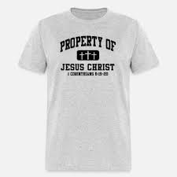
God Cares About All of You

Slide 50
Hymn #240
CCLI# 245077

Slide 51
Fairest Lord Jesus,
Ruler of all nature,
O Thou of God and man the Son:
Thee will I cherish, Thee will I honor,
Thou my soul’s glory, joy, and crown.

Slide 52
Fair are the meadows,
Fairer still then woodlands,
Robed in the blooming garb of spring:
Jesus is fairer, Jesus is purer,
Who Makes the woeful heart to sing.

Slide 53
Fair is the sunshine,
Fairer still the moonlight,
And all the twinkling starry host:
Jesus shines brighter, Jesus shines purer,
Than all the angels heaven can boast.

Slide 54
Beautiful Savior!
Lord of all the nations!
Son of God and Son of Man!
Glory and honor, Praise, adoration,
Now and forevermore be Thine!

Slide 55
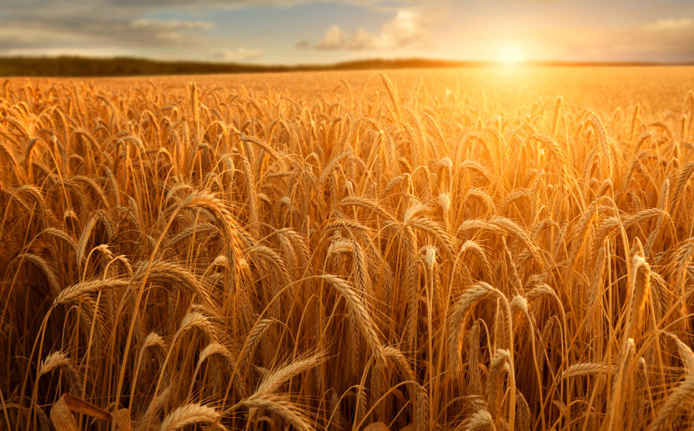
BENEDICTION

Slide 56
POSTLUDE
Have a
good week!

